Slide 1
Understanding 8086
Course Code: 0052
Course Title: Computer Organization and Architecture
Dept. of Computer Science
Faculty of Science and Technology
Lecturer No: | 3 | Week No: | 3 | Semester: | Summer 23-24
Lecturer: | Md. Faruk Abdullah Al Sohan; faruk.sohan@aiub.edu

Slide 2
Lecture Outline
1. A brief survey of 8086 family
2. The architecture of the 8086
3. The registers and their special functions
4. Overall structure of the IBM PC
5. The memory organization
6. I/O ports, DOS and BIOS routines

Slide 3
Intel 8086 Family of Microprocessors
Based on Intel 8086 family of microprocessor
IBM PC (8088)
PC XT (8088)
PC AT (80286)
PS/1 (80286)
PS/2 (8086/ 80286/ 80386/ 80486)
Some PC compatible Laptop models (80186)

Slide 4
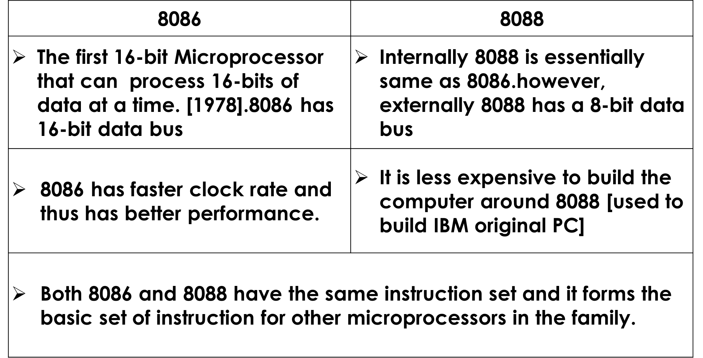
The 8086 and 8088 Microprocessors

Slide 5
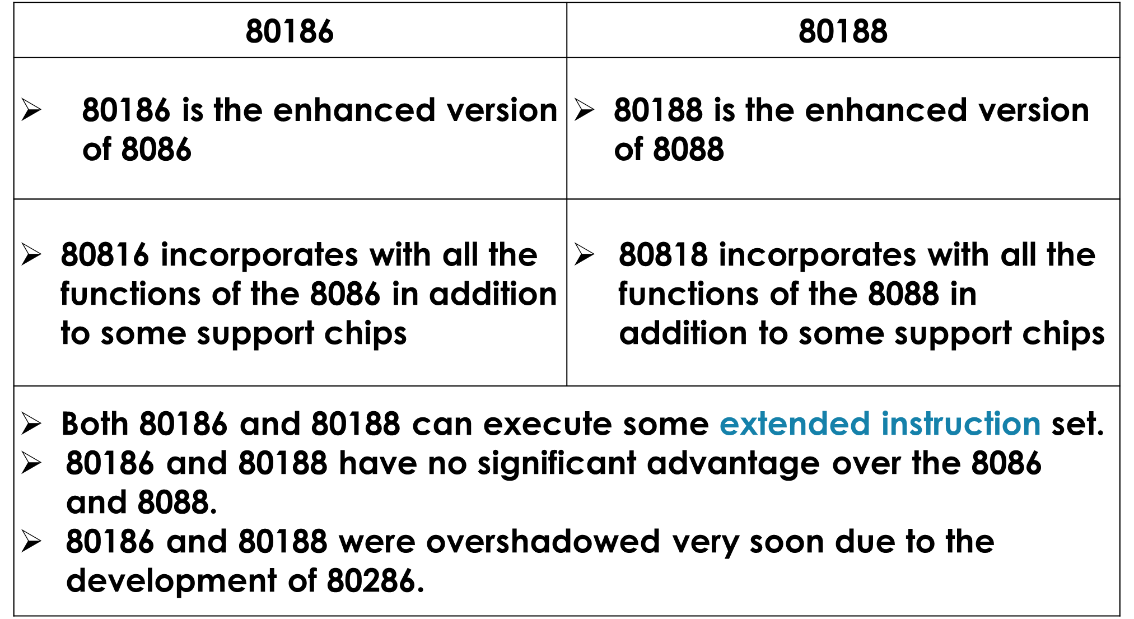
80186 and 80188 Microprocessors

Slide 6
The 80286 Microprocessor
80286 is 16-bit microprocessor and was introduced in 1982.
It operates faster than the 8086 [12.5 MHz vs 10MHz]
Two modes of operation
  Real address:
        In this mode, microprocessor behaves like 8086 and programs for 8086 can be executed without modification.
  Protected Virtual address:
    Multitasking: 80286 supports multi-tasking. So, it can operate several tasks at the same time.
    Memory protection: Protects the memory used by one program from the actions of another program.

Slide 7
The 80286 Microprocessor(Cont.)
More addressable Memory: The protected mode can address 16 megabytes of memory as opposed to 1MB in 8086 and 8088
Virtual Memory in protected mode: 80286 can consider external storage or disk as a physical memory and execute large programs [up to 1GB or 2^30 bytes]

Slide 8
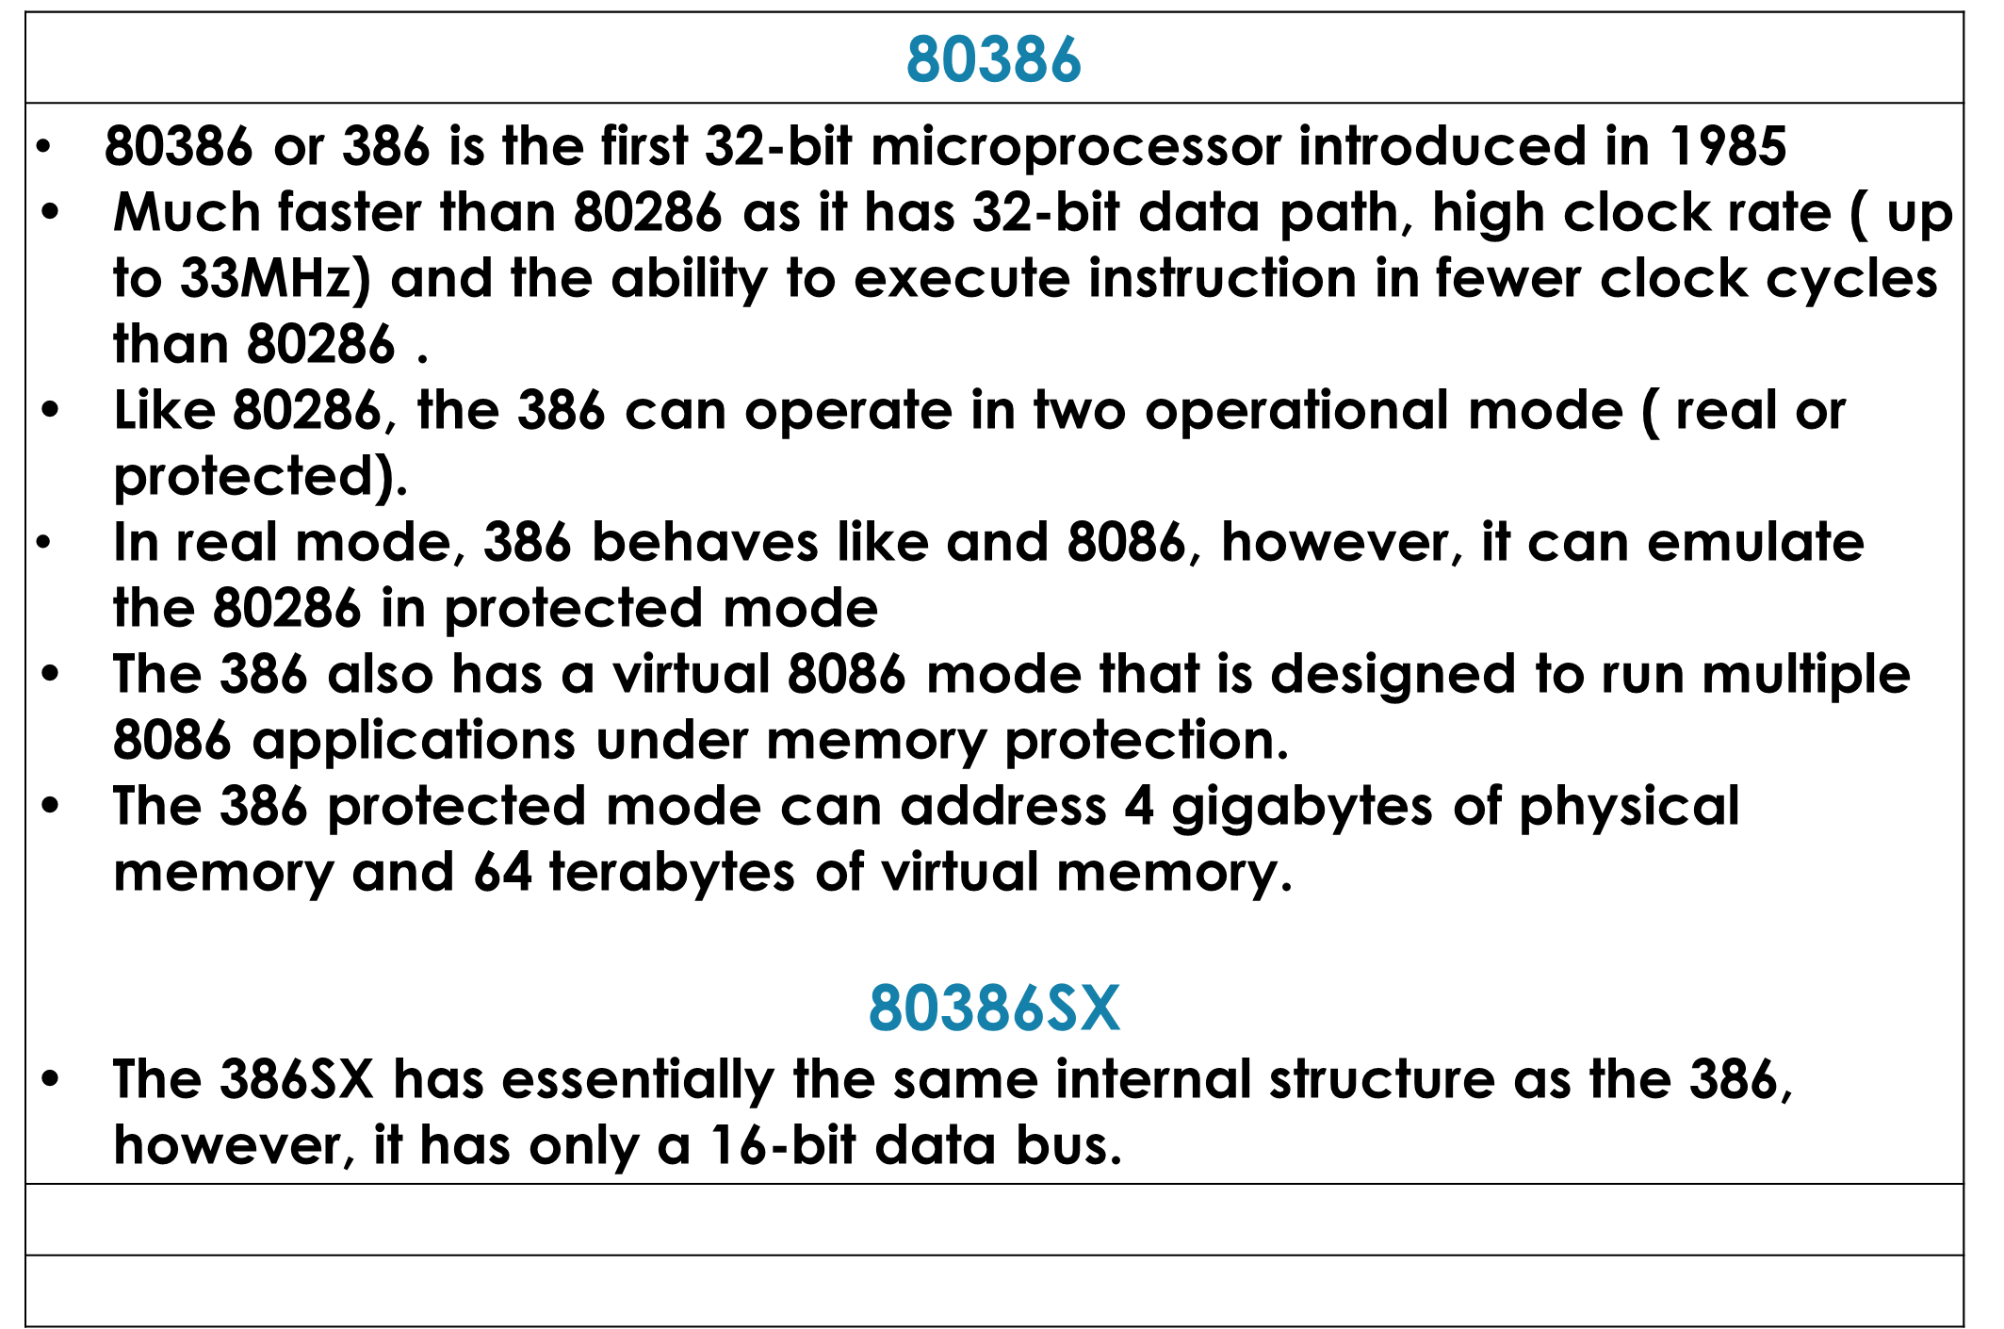
The 80386 and 80386SX Microprocessor

Slide 9
The 80486 and 80486SX Microprocessor
80486 or 486 is another 32-bit microprocessor introduced in 1989.
486 is the fastest and most powerful microprocessor in the family
486 incorporates all the functions of the 386 with some other supportive chips including 80387 numeric processor like 80387.
80387 numeric processor performs floating-point number operations.
An 8-KB cache memory serves as a fast memory area to buffer the data coming from a slower memory unit.
With numeric processor, cache memory and faster design, 486 is three times faster than 386 running at the same clock speed.
80486SX
The 486SX has essentially the same internal structure as the 486, however, it does not have any floating-point processor.

Slide 10
Organization of the 8086/8088 Microprocessor
8086 and 8088 has the simplest structure and they provide the insights to the most advanced processors.
As both 8086 and 8088 essentially has the same structure, we will use the term “8086” for both.

Slide 11
Registers
Information inside the microprocessor is stored in registers.
Registers are classified according to their functions.
    Data register holds the data for an operation
    Address register holds the address for an instruction or data.
    Status register keeps the current status of the processor.
8086 has four general registers.
  Address registers: 1) segment 2) pointer and 3) index register
  Status Register: 4) FLAGS Register
There are total fourteen 16-bit registers.
*** The good news is, we DO NOT need to memorize them at all. it will become familiar as we go on. :)

Slide 12
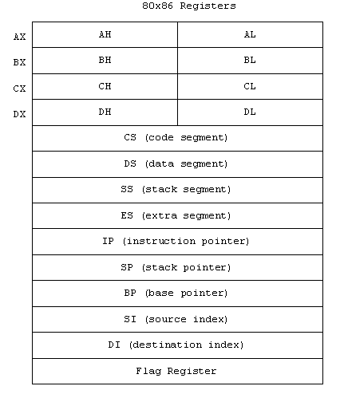
8086 Registers
General Register
Accumulator
Base
Counter
Data
Segment Register
Pointer and Index Register
FLAGS Register

Slide 13
AX: Accumulator Register
*** Address registers store addresses and instructions and data in memory.
Use of AX register generates shortest machine code.
Thus, AX is preferred register to use in arithmetic, logic and data transfer instructions.
In multiplication and division, one of the numbers involved must be in AX or AL.
Input and Output also require the use of AL or AX

Slide 14
BX: Base Register
BX also serves as an address register
i.e. Table look-up instruction (XLAT)
CX: Count Register
CX used as Program Loop counter.
CX also used as a counter (REP-repeat) to control string operations.
CL is used as count in bit rotation and shifting instructions
DX: Data Register
DX is used in multiplication, division and I/O operations

Slide 15
Explain
Examples (in x86 16-bit): AX, BX, CX, DX
Sub-parts: Can be accessed as high/low bytes (e.g., AX → AH, AL)
Usage: Arithmetic operations, data transfer, loop counters (CX often used as counter)
Analogy: Like scratch paper for doing calculations.

Slide 16
Memory Recall
List One special function of AX, BX, CX, and DX

Slide 17
Segment Registers: CS,DS,SS,ES
Memory is a collection of bytes.
Each memory bytes has an address starting with 0.
The 8086 assigns 20-bit physical address to its memory location.[i.e. we can address 2^20(1MB) of memory]. Thus the first byte of the memory addresses:
Binary representation | Hex Representation
0000 0000 0000 0000 0000 | 00000h
0000 0000 0000 0000 0001 | 00001h
0000 0000 0000 0000 0010 | 00002h
0000 0000 0000 0000 0011 | 00003h
0000 0000 0000 0000 0100 | 00004h
***So what will be the highest address of 20-bit memory address?

Slide 18
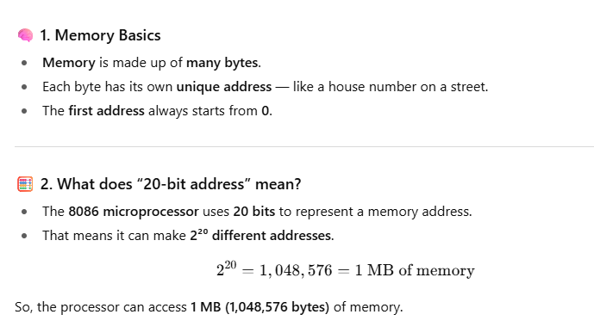
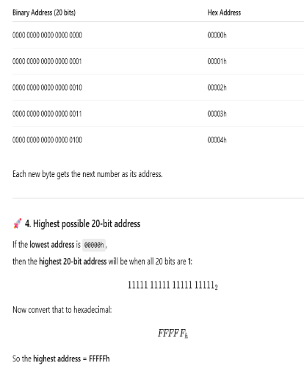
Explain

Slide 19
Using 20-bit Address in 16-bit Processor
To explain segment register’s function, lets have a look on the idea of memory segments.
How can we fit 20-bit address into 16-bit register?
Memory Partitioning into segments
A memory segment is a block of 2^16(64KB) consecutive memory bytes.
Each segment is identified by segment number.[starts with 0]
A segment number is 16-bit [thus, highest value FFFFh].
Within a segment, a memory location is specified by giving an offset.
Offset: Number of bytes from the beginning of segment.
  i.e., for a 64KB segment, the offset can be given as16-bit number.
  The first byte in a segment has offset 0000h.
  The Last byte in a segment has offset FFFFh

Slide 20
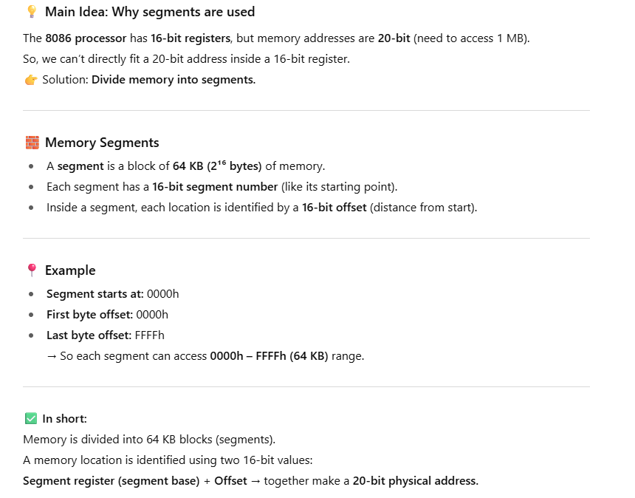
Explain

Slide 21
Segment : Offset address
A memory segment may be specified by providing a segment number and an offset.
Memory segment is written in the form of segment : offset.
The representation of segment : offset is known as logical address.
  e.g., A4FB:4872h means
  offset 4872h within
  segment A4FBh

Slide 22
How to obtain 20-bit physical address in a 16-bit microprocessor?
The 8086 shifts the segment address 4-bits to the left [i.e. multiply by 10h].
Add the offset address to the segment address.
  i.e. to get the 20-bit physical address from A4FB:4872h,
  A4FB0h [multiplied segment with 10]
  4872h
  A9822h [20-bit physical address]

Slide 23
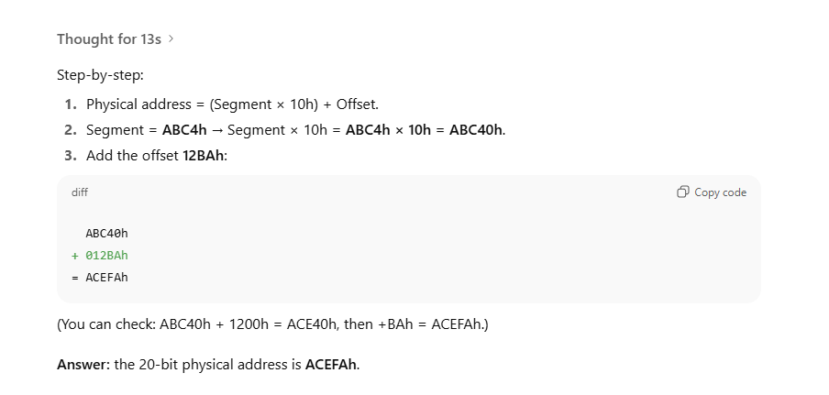
Task
Find the 20-bit address of ABC4:12BAh?

Slide 24
Location of Segments
Segment 0 starts at address 0000:0000h=00000h and ends at 0000:FFFFh=0FFFFh.
Segment 1 starts at address 0001:0000h=00010h and ends at 0001:FFFFh=1000Fh.
Segment 10 (16) starts at address 0010:0000h=00100h and ends at 0010:FFFFh=100FFh.
Observations:
The segments start at every 10h =16 bytes
The starting address of a segment always ends with 0h.
We call 16 bytes a paragraph.
An address divisible by 16 (ends with hex 0 ) is called a paragraph boundary.

Slide 25
Example-1
Physical address of a memory location is 1256Ah, find the address in segment : offset form for segment 1256h?
Physical address = Segment X 10h + offset
Offset = Physical address - Segment
Let's consider, X = offset in 1256h. Thus,
1256Ah=12560h [segment 1256 multiplied by 10] + X
  X = 1256Ah-12560h
  X = Ah
  X = 000Ah
Segment : offset = 1256:000Ah

Slide 26
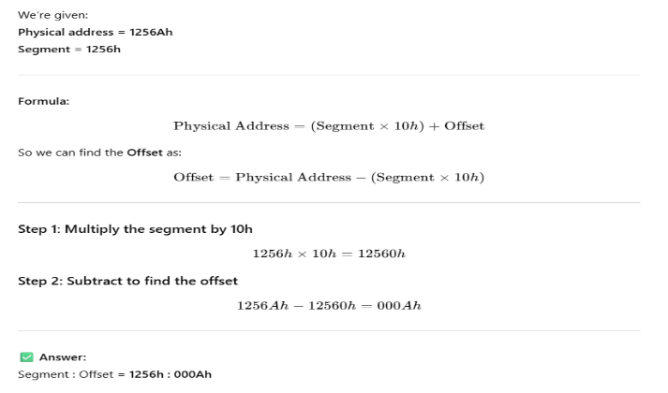
Explain

Slide 27
Example-2
Physical address of a memory location is 1256Ah, find the address in segment : offset form for segment 1240h?
Let's consider, X = offset in 1240h. Thus,
1256Ah=12400h [segment 1256 multiplied by 10] + X
  X = 1256Ah-12400h
  X = 16Ah
  X = 016Ah
Segment : offset = 1240:016Ah

Slide 28
Calculate the Segment Number
A physical address 80FD2h and offset BFD2h is given. Calculate the segment .
Physical address = Segment X 10h + offset
Thus,
Segment X 10h = Physical address - offset
Segment = (Physical address - offset ) / 10h
Segment = (80FD2h - BFD2h)/10h
Segment = (75000h)/10h
Segment = 7500h

Slide 29
Task
Find the physical address of memory location 0A51:CD90h ?
A memory location has physical address 4A37Bh. Compute the offset if segment number is 40FFh.
  Compute the Segment if offset number is 123Bh.

Slide 30
Program Segments
Machine language program consists instruction and data.
Processor uses stack to implement procedure calls.
The program code are loaded into Code Segment (CS) of memory.
Data are loaded into Data segment (DS) of memory
Stack are loaded into Stack Segment (SS ) of memory
The 8086 uses four segment registers (CS,DS,SS, ES) to hold segment numbers.
Any program needs access for second data segment may use Extra segment (ES).
## 86 divides memory into segments so instructions, data, and stack can be stored and accessed efficiently using special segment registers (CS, DS, SS, ES).
Each register points to a different memory segment — Code for instructions, Data for variables, Stack for procedure calls, and Extra for additional data access.

Slide 31
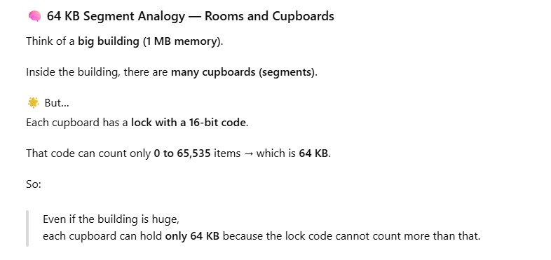
Program Segments(Cont'd…)
A memory segment does not necessarily occupy the entire 64KB in a memory segment.
Programs segment of less than 64KB are placed close together due to its overlapping nature.
At any given time, only four memories are active and thus these four segments are accessible.
However, contents of memory segments can be modified by a program to address different segments.

Slide 32

Pointer and Index Registers
The registers SP,BP,SI and DI usually point to the memory locations.
  Registers contain the offset address of Memory location
  Unlike segment registers Index registers can be used in arithmetic and other operations.

Slide 33
Stack Pointer (SP)
The stack pointer (SP) is used together with SS to access the stack segment.
Base Pointer (BP)
BP is used to access data on the stack.
Unlike SP, BP can be used to access data in the other segments

Slide 34
Source Index (SI)
SI is used to point to memory locations in the data segment addressed by DS.
Consecutive memory locations can be accessed by incrementing the content of SI.
Destination Index (DI)
DI is also used to point memory location.
String operations use DI to access memory locations addressed by ES.

Slide 35
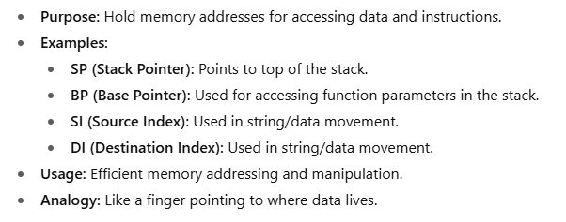

Slide 36
Instruction Pointer (IP)
The memory registers are for data access.
The 8086 uses CS and IP registers to access instructions.
CS contains the segment number and IP contains the offset of next register.
IP is updated each time after an instruction execution to point to the next pointer.
Unlike other registers, IP can not be directly manipulated by an instruction. (i.e. an instruction may not contain IP as its operand.)

Slide 37
FLAGS Register
FLAGS register is used to indicate the status of the microprocessor.
Indication is done by setting of individual bits [flags].
There are two kinds of FLAGS
  Status flags: Reflect the result of an instruction executed by the processor. [More: chapter-5]
      e.g. If AX-BX results to 0, the ZF (Zero Flag) is set to 1 (True).
  Control flags: Enable or Disable certain operations of the processor
    e.g. if IF (Interrupt Flag) is cleared (set to 0), inputs from keyboard are ignored by the processor. [More: chapter-11]

Slide 38
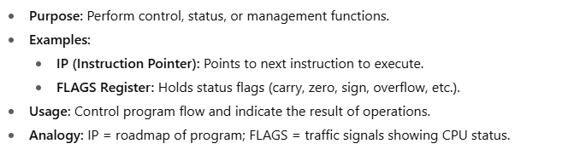

Slide 39
The Organization of the PC
A computer is made up of both Hardware and Software.
Software controls the hardware operations.
Thus, we need to understand the coordination of hardware and software to completely understand the operation of computer.

Slide 40
The Operating System
The purpose of OS is to coordinate the operations between all the devices of the computer system.
The OS functions:
  Reading and executing the command typed by users
  Performing I/O operations
  Generating error messages
  Managing memory and other resources
  DOS was designed for 8086 processors
DOS could manage only 1 MB memory and doesn’t support multitasking.

Slide 41
DOS OS
  DOS performs reading and writing information on disk
  Programs and other information stored on a disk are organized into files.
  Each file has a file name [within 1 to 8 characters.] followed by an extension.
  The extension is used for file type.

Slide 42
BIOS
The BIOS routine perform I/O operation for the PC
However, DOS routine operates over the entire PC family.
BIOS routines are machine specific.
BIOS also performs circuit checking and loading of DOS routine.
The address of the BIOS routines is called interrupt vectors.

Slide 43
Memory Organization of the PC
8086/8088 processor can address 1MB or memory.
But all the memory can not be used by application program as some memory locations have special meaning to the processor.
    e.g., First KB (00000h to 003FFh) is used for interrupt vectors.
Other memory locations are reserved by IBM for special purposes (i.e., BIOS routines and Video display memory).

Slide 44
Memory Partition into Disjoint Segments
Partitioning the memory into disjoint segments. [Ref: Figure: 3.4]
start Segment 00000h= 0000:0000 ends at Segment 0FFFFh
start Segment 10000h=1000:0000 ends at Segment 1FFFFh
start Segment 20000h=2000:0000 ends at Segment 2FFFFh
… … …
start Segment F0000h ends at Segment FFFFFh [Total 16 disjoint segments]
The Only first 10 disjoint memory segments are used by DOS for loading and running application programs.
The ten segments 0000h to 9000h gives 640KB.
The memory sizes of 8086/8088-based PCs are given in terms of these memory segments.
e.g., a PC with 512-KB memory has eight of these memory segments.

Slide 45
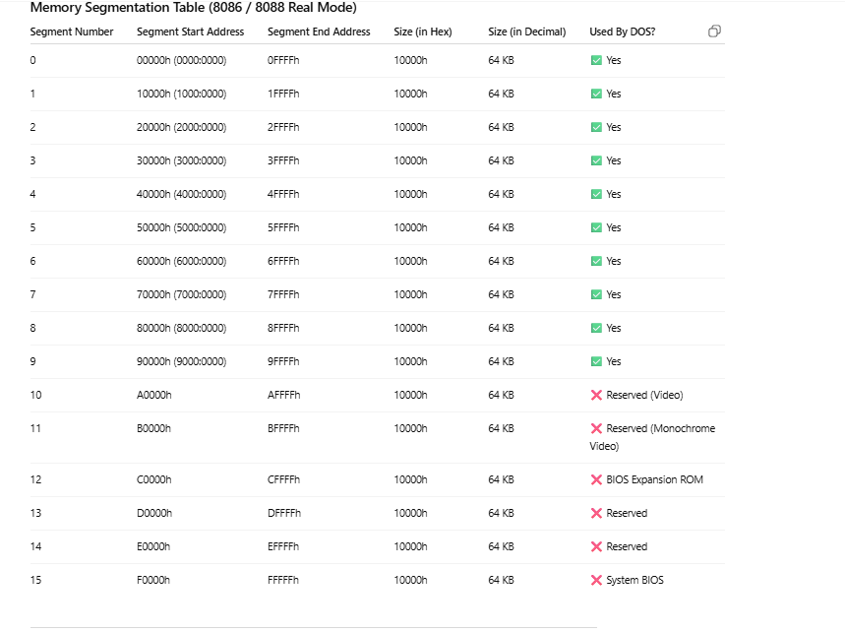
explain

Slide 46
Key Points to Remember
Total no. of disjoint segments = 16
Each segment = 64 KB
First 10 segments (0000h–9000h) are usable by DOS → 10 × 64 KB = 640 KB
That is why old PCs are said to have 640 KB of usable memory.
Segments above 640 KB are reserved for BIOS and hardware.
Example
If a PC has 512 KB RAM, it means:
512 KB ÷ 64 KB = 8 segments
So, segments 0000h to 7000h are present.

Slide 47
Memory Map of the PC
BIOS | F0000h
Reserved | E0000h
Researved | D0000h
Researved | C0000h
Video | B0000h
Video | A0000h
Application Program Area
DOS
BIOS and DOS data | 00400h
Interrupt Vectors | 00000h

Slide 48
Start-up Operation
When PC is powered up, the 8086/8088 processor is put in reset state.
The register CS = FFFFh and IP = 0000h.
First instruction it executes, is located at FFFF0h.
This memory location is ROM.
ROM contains an instruction that transfers control to the starting point of the BIOS routines.
The BIOS routine first check for system and memory errors.
BIOS routines then initialize the interrupt vectors and BIOS data area.
Finally, BIOS loads the operating system from the system disk.
  step-1: BIOS loads boot program
  step-2: Boot program loads the actual operating systems routines
Boot program is named so because computer pulling itself by bootstraps.
Once OS is loaded into memory, COMMAND.COM is given control

Slide 49
References
Assembly Language Programming and Organization of the IBM PC, Ytha Yu and Charles Marut, McGraw Hill, 1992. (ISBN: 0-07-072692-2).
https://www.britannica.com/technology/DNA-computing
https://www.includehelp.com/embedded-system/memory-organization-in-the-8086-microprocessor.aspx

Slide 50
Books
Assembly Language Programming and Organization of the IBM PC, Ytha Yu and Charles Marut, McGraw Hill, 1992. (ISBN: 0-07-072692-2).
Essentials of Computer Organization and Architecture, (Third Edition), Linda Null and Julia Lobur
W. Stallings, “Computer Organization and Architecture: Designing for performance”, 67h Edition, Prentice Hall of India, 2003, ISBN 81 – 203 – 2962 – 7
Computer Organization and Architecture by John P. Haynes.

